Slide 1

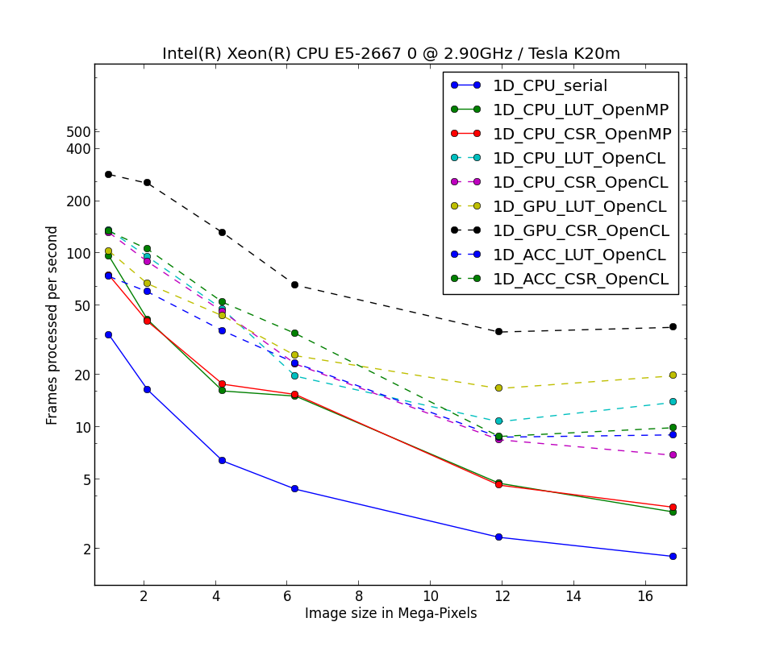
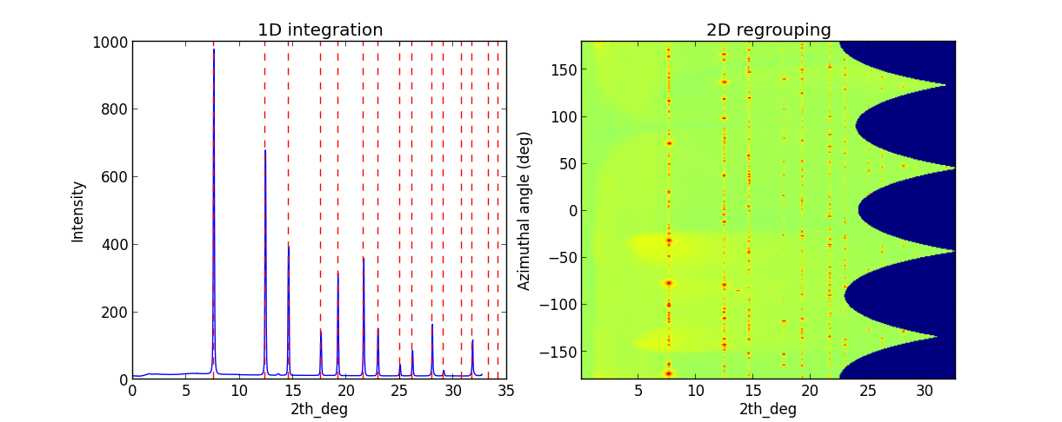
The Fast Azimuthal Integration Python library
Giannis Ashiotis, Jérôme Kieffer
ESRF, 71 avenue des Martyrs, 38000 Grenoble, France
PyFAI is an open-source software package, written in Python, for performing azimuthal integration and 2D-regrouping on area detector frames for SAXS, WAXS and XRPD experiments. This is done by histogramming pixel positions weighted by the pixel intensity. Pixels spanning over more than one histogram bin contribute to the neighbouring bins accordingly. This results in greatly reduced noise in the diffraction pattern. To achieve the necessary execution speeds required by such experiments, the concept of a look-up table was introduced. Furthermore the code is parallelized using OpenCL, which achieves very good performances even on very cost-effective graphics cards.
Introducton
Azimuthal integration allows the use of area detectors for recording powder diffraction patterns
Data reduction step is very time-consuming → bottleneck
2D raster scans with pencil beam
diffraction tomography
Recent developments in PyFAI address this issue by achieving the required execution speeds, without sacrificing any accuracy
Experiment Description
PyFAI offers 40 detector definitions (Pilatus, Maxipix...)
Support for optically coupled CCD detectors w/ geometric distortion correction
Custom definitions following NeXus convention
sample-detector distance
PONI
3D rotation of detector
Binning of detectors → larger pixel size
Calibration
Selection of 10 calibrants
Powder diffraction (ceria, corundum, gold, silicon, …)
Small angle scattering (silver behenate, Tetradecanol, …)
Pick-picking done using Massif extraction and Blob detection algorithms
Integration
User has three options when it comes to pixel-splitting:
No splitting
Bounding box splitting
Tight pixel splitting
At this point, for correct error calculation avoid using pixel-splitting
Parallel implementation using OpenCL
Azimuthal integration is a scatter operation
Look Up Table (LUT) → sparse matrix – dense vector product
Easier to parallellise with OpenCL / PyOpenCL
Now code can run on :
CPUs
GPUs
Accelerators
Speeds of 700 Mpixel/s
Signal separation
PyFAI, through the AzimuthalIntegrator or the Geometry class, allows diffraction image generation for testing purposes
AzimuthalIntegrator.calcfrom1d
A script is also available to regenerate the diffraction image using the integrated powder pattern
pyFAI-calib → validate
Another method of the AzimuthalIntegrator class is separate, which can separate the amorphous scattering from the Bragg peaks
AzimuthalIntegrator.separate
Applications in: High-pressure diffraction experiments
Serial crystallography (see image)
Conclusions
PyFAI succeeds in addressing the challenges that arise from such experiments as SAXS, WAXS and XRPD. It even goes further by offering features that find applications in other type of experiments like serial crystallography. And with processing speed reaching 700 Mpixel/s, it is able to handle the huge data streams coming from modern detectors
Acknowledgements
Claudio Ferrero – head of the Data Analysis Unit
Andy Götz – head of the Software Group
LinkSCEEM-2 – fanatical support
Dimitris Karkoulis, Zubair Nawaz, Aurore Deschildre, Frédéric Picca – contributors
References

